Slide 1

Natural Language Processing
Rohit Kate
Sequence Labeling
Reading: Sections 5.1 & 5.3, Textbook 1

Slide 2
Sequence Labeling
Some NLP tasks can be casted as sequence labeling task
POS tagging
Named entity recognition
Given an input sequence, output a label for its each element
label1 label2 label3 … labelN
word1 word2 word3 … wordN
Sequence Labeling

Slide 3
Sequence Labeling
In contrast, in sequence classification, the entire sequence is given one label
Grammatical or not
Sentiment analysis: positive or negative
Spam filtering
label
word1 word2 word3 … wordN
Sequence Classification

Slide 4
Sequence Labeling: POS Tagging
Given a tokenized sentence, tag each word with its part-of-speech (POS) tag
Lowest level of syntactic analysis
NOUN VERB DT NOUN CONJ VERB TO VERB PRP PREP DT NOUN
John saw the saw and decided to take it to the table.

Slide 5
Why do POS tagging?
Useful for subsequent syntactic analysis: Which are noun/verb phrases? Where are the prepositional phrases attached?
Identifying nouns can help information retrieval as they are the important words usually searched for
Can help in identifying names, places etc. for information extraction
Can help word sense disambiguation and subsequent semantic analysis
Can help speech synthesis system to pronounce words correctly,
E.g. “lead”
“The mayor will lead against lead in water.”
Verb
Noun

Slide 6
POS Tagging is Not Trivial
The same word can have different tags in different sentences or even in the same sentence
“Like” can be a verb or a preposition
I like/VERB candy.
Time flies like/PREPOSITION an arrow.
“Around” can be a preposition, particle, or adverb
I bought it at the shop around/PREPOSITION the corner.
I never got around/PARTICLE to getting a car.
A new car costs around/ADVERB $25K.
“Saw” could be a verb or a noun
John saw/VERB the saw/NOUN
Adapted from Ray Mooney’s slide.

Slide 7
POS Tagging is Not Trivial
Degree of ambiguity in English (based on Brown corpus)
11.5% of words are ambiguous
Rest of them are used with only one POS tags
40% of word instances are ambiguous
Some frequently used words are ambiguous
New words or names may be encountered or get invented
Zizappi/NOUN googled/VERB geekishly/ADVERB.
Can’t simply use a dictionary of words with their usual POS tags

Slide 8
POS Tagging Approaches
Hand-crafted rules
Created by experts
Automatically learned rules
From annotated data
Statistical modelling
ML methods Trained on
annotated data
Neural network based approaches
Interpretability
Performance

Slide 9
Some Relevant Information for POS Tagging
The word itself
And its most likely POS tag
E.g. “eats”: more likely to be noun or verb?
Nearby words
POS tags of nearby words
Suffixes and prefixes of the word
E.g. “ly” suffix usually indicates adverb
Capitalization
Usually proper nouns
This and other information are used for creating rules or are used as features to train machine learning models.

Slide 10
Hand-Crafted Rules
Early approaches for POS tagging from the 60s
Use a dictionary to assign each word in a sentence a list of potential POS tags
Use a few thousand hand-crafted rules based on linguistic knowledge to narrow down the list to one POS tag for each word
Example: If the next word is adjective and the previous word is not a verb then eliminate adverb tag…
General architecture remained same but rule sets increased in size over time

Slide 11
Hand-Crafted Rules
POS Tagger of Constraint Grammar Parser for English (EngCG):
From early 90s
Based on hand-crafted rules
Considered 139 POS tags
Reported accuracy of 99.7%
Note: It is easy to achieve a fairly high accuracy in POS tagging (e.g. 95% accuracy using just the most likely POS tag for each word)
Used AI problem solving technique known as constraint satisfaction

Slide 12
Hand-Crafted Rules
POS Tagger of Constraint Grammar Parser for English (EngCG):
Used a large hand-crafted dictionary with possible POS tags of each word
Used a set of rules to specify constraints for POS tags of words in the same sentence
1100 rules based on syntax
200 heuristic rules
Example constraint rule: “A past participle cannot immediately follow a pronoun at the start of a sentence”
For a sentence, begin with all possible tags, then apply constraints and eliminate tags that violate constraints till only unique tags are left

Slide 13
Learning Based Approaches
With the availability of enough high-quality training data (e.g. Penn Treebank), learning based approaches started performing better than hand-crafted rules
Generally, learning-based approaches have been found to be more effective overall, taking into account the total amount of human expertise and effort involved

Slide 14
Recall: Penn Treebank
Very widely used resource in NLP
Created in the 90s at Univ of Pennsylvania
Text data of three years of Wall Street Journal (WSJ) news stories
98,732 news stories, 1.2 million words
Around 40,000 sentences from a subset of stories were manually annotated by linguists with syntactic parses
Used for training machine learning methods
Additional 2,416 sentences are used for evaluating
The POS tags we saw last time were from this corpus
Today also includes data from Switchboard corpus of phone conversations
https://catalog.ldc.upenn.edu/LDC99T42

Slide 15
First Sentence from Penn Treebank
( (S
(NP-SBJ
(NP (NNP Pierre) (NNP Vinken) )
(, ,)
(ADJP
(NP (CD 61) (NNS years) )
(JJ old) )
(, ,) )
(VP (MD will)
(VP (VB join)
(NP (DT the) (NN board) )
(PP-CLR (IN as)
(NP (DT a) (JJ nonexecutive) (NN director) ))
(NP-TMP (NNP Nov.) (CD 29) )))
(. .) ))
POS tags
15
Notes:
15

Slide 16
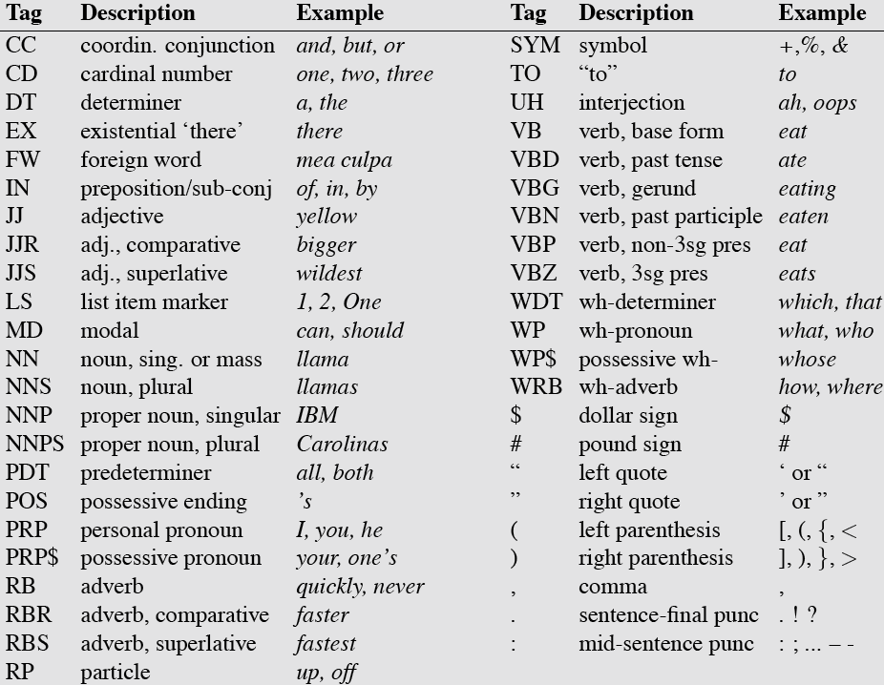
POS Tags in Penn Treebank

Slide 17
Brill Tagger
Developed by Eric Brill in the mid-90s
Uses rules but they are automatically learned from annotated data
Also known as transformation-based tagging
First label each word in the sentence with the most likely POS tag for that word
Transform the tags by applying the transformation rules in order
Rule templates:
Change tag A to B when:
The following word is tagged Z
The word two before is tagged Z
One of the preceding words is tagged Z
The preceding word is tagged Z and the following word is tagged W
…

Slide 18
Brill Tagger
How to learn the rules (i.e. instantiate the rule templates)?
Efficiently try all possible instantiations of the templates and include the one that corrects most tags when tried on the training corpus
Iterate the above step till transformations don’t help much
Performs competetively

Slide 19
Sequence Labeling as Classification
Sequence labeling task can be formulated as a classification task over the sequence
Classify each token independently
Target: POS tag
E.g. John → NNP/VB/DT…
Features: The word and the surrounding words (within a window)
The window slides over the sequence

Slide 20
Sequence Labeling as Classification
John saw the saw and decided to take it to the table.
classifier
NNP
Adapted from Ray Mooney’s slide.
20
Notes:
20

Slide 21
Sequence Labeling as Classification
John saw the saw and decided to take it to the table.
classifier
VBD
21
Notes:
21

Slide 22
Sequence Labeling as Classification
John saw the saw and decided to take it to the table.
classifier
DT
22
Notes:
22

Slide 23
Sequence Labeling as Classification
John saw the saw and decided to take it to the table.
classifier
NN
23
Notes:
23

Slide 24
Sequence Labeling as Classification
John saw the saw and decided to take it to the table.
classifier
CC
24
Notes:
24

Slide 25
Sequence Labeling as Classification
John saw the saw and decided to take it to the table.
classifier
VBD
25
Notes:
25

Slide 26
Sequence Labeling as Classification
John saw the saw and decided to take it to the table.
classifier
TO
26
Notes:
26

Slide 27
Sequence Labeling as Classification
John saw the saw and decided to take it to the table.
classifier
VB
27
Notes:
27

Slide 28
Sequence Labeling as Classification
John saw the saw and decided to take it to the table.
classifier
PRP
28
Notes:
28

Slide 29
Sequence Labeling as Classification
John saw the saw and decided to take it to the table.
classifier
IN
29
Notes:
29

Slide 30
Sequence Labeling as Classification
John saw the saw and decided to take it to the table.
classifier
DT
30
Notes:
30

Slide 31
Sequence Labeling as Classification
John saw the saw and decided to take it to the table.
classifier
NN
31
Notes:
31

Slide 32
Sequence Labeling as Classification: Using Outputs as Inputs
Better input features are usually the tags of the surrounding tokens, but these are not available yet
Can use category of either the preceding or succeeding tokens by going forward or back and using previous output
32
Notes:
32

Slide 33
Forward Classification
John saw the saw and decided to take it to the table.
classifier
NNP
33
Notes:
33

Slide 34
Forward Classification
NNP
John saw the saw and decided to take it to the table.
classifier
VBD
34
Notes:
34

Slide 35
Forward Classification
NNP VBD
John saw the saw and decided to take it to the table.
classifier
DT
35
Notes:
35

Slide 36
Forward Classification
NNP VBD DT
John saw the saw and decided to take it to the table.
classifier
NN
36
Notes:
36

Slide 37
Forward Classification
NNP VBD DT NN
John saw the saw and decided to take it to the table.
classifier
CC
37
Notes:
37

Slide 38
Forward Classification
NNP VBD DT NN CC
John saw the saw and decided to take it to the table.
classifier
VBD
38
Notes:
38

Slide 39
Forward Classification
NNP VBD DT NN CC VBD
John saw the saw and decided to take it to the table.
classifier
TO
39
Notes:
39

Slide 40
Forward Classification
NNP VBD DT NN CC VBD TO
John saw the saw and decided to take it to the table.
classifier
VB
40
Notes:
40

Slide 41
Forward Classification
NNP VBD DT NN CC VBD TO VB
John saw the saw and decided to take it to the table.
classifier
PRP
41
Notes:
41

Slide 42
Forward Classification
NNP VBD DT NN CC VBD TO VB PRP
John saw the saw and decided to take it to the table.
classifier
IN
42
Notes:
42

Slide 43
Forward Classification
NNP VBD DT NN CC VBD TO VB PRP IN
John saw the saw and decided to take it to the table.
classifier
DT
43
Notes:
43

Slide 44
Forward Classification
NNP VBD DT NN CC VBD TO VB PRP IN DT
John saw the saw and decided to take it to the table.
classifier
NN
44
Notes:
44

Slide 45
Backward Classification
John saw the saw and decided to take it to the table.
classifier
NN
45
Disambiguating “to” in this case would be even easier backward.
Notes:
45

Slide 46
Backward Classification
NN
John saw the saw and decided to take it to the table.
classifier
DT
46
Disambiguating “to” in this case would be even easier backward.
Notes:
46

Slide 47
Backward Classification
DT NN
John saw the saw and decided to take it to the table.
classifier
IN
47
Disambiguating “to” in this case would be even easier backward.
Notes:
47

Slide 48
Backward Classification
IN DT NN
John saw the saw and decided to take it to the table.
classifier
PRP
48
Disambiguating “to” in this case would be even easier backward.
Notes:
48

Slide 49
Backward Classification
PRP IN DT NN
John saw the saw and decided to take it to the table.
classifier
VB
49
Disambiguating “to” in this case would be even easier backward.
Notes:
49

Slide 50
Backward Classification
VB PRP IN DT NN
John saw the saw and decided to take it to the table.
classifier
TO
50
Disambiguating “to” in this case would be even easier backward.
Notes:
50

Slide 51
Backward Classification
TO VB PRP IN DT NN
John saw the saw and decided to take it to the table.
classifier
VBD
51
Disambiguating “to” in this case would be even easier backward.
Notes:
51

Slide 52
Backward Classification
VBD TO VB PRP IN DT NN
John saw the saw and decided to take it to the table.
classifier
CC
52
Disambiguating “to” in this case would be even easier backward.
Notes:
52

Slide 53
Backward Classification
CC VBD TO VB PRP IN DT NN
John saw the saw and decided to take it to the table.
classifier
VBD
53
Disambiguating “to” in this case would be even easier backward.
Notes:
53

Slide 54
Backward Classification
VBD CC VBD TO VB PRP IN DT NN
John saw the saw and decided to take it to the table.
classifier
DT
54
Disambiguating “to” in this case would be even easier backward.
Notes:
54

Slide 55
Backward Classification
DT VBD CC VBD TO VB PRP IN DT NN
John saw the saw and decided to take it to the table.
classifier
VBD
55
Disambiguating “to” in this case would be even easier backward.
Notes:
55

Slide 56
Backward Classification
VBD DT VBD CC VBD TO VB PRP IN DT NN
John saw the saw and decided to take it to the table.
classifier
NNP
56
Disambiguating “to” in this case would be even easier backward.
Notes:
56

Slide 57
Problems with Sequence Labeling as Classification
57
Not easy to integrate information from category of tokens on both sides
Difficult to propagate uncertainty between decisions and “collectively” determine the most likely joint assignment of categories to all of the tokens in a sequence
Notes:
57

Slide 58

Sequence Labeling Using RNNs
VBD
DT
NN
Output layer
Output layer
Output layer
LSTM Cell (unrolled)
…
…
saw
the
saw
58
Recurrent neural networks are very suitable for sequence labeling
Make it output
Notes:
58

Slide 59
Sequence Labeling Using RNNs
59
However, RNNs see the sequence only in forward direction
Seeing the sequence in backward direction is also helpful
How to make RNNs see in both the directions?
Notes:
59

Slide 60

Bidirectional LSTM (Bi-LSTM)
One LSTM processes the sequence forward, another backward
x_{t-1}
x_{t}
x_{t+1}
h_{t-1}
Output layer
h_{t}
Output layer
h_{t+1}
Output layer

Slide 61
Bidirectional LSTM (Bi-LSTM)
Useful when output at any point could be influenced from either side
Backward RNN is like flipping the sequence and then feeding it to the forward RNN
Hidden layers at each time step are concatenated to form the final cell output that goes to the output layer
Encodes information from the entire sequence

Slide 62
Bidirectional RNNs
Similarly GRUs can also be bidirectional
Bidirectional layers can also be stacked to form multiple layers
Learn increasingly more abstract concepts
Easy to do so using a deep learning library
Bidirectional RNNs have shown good performance on POS tagging

